Slide 1
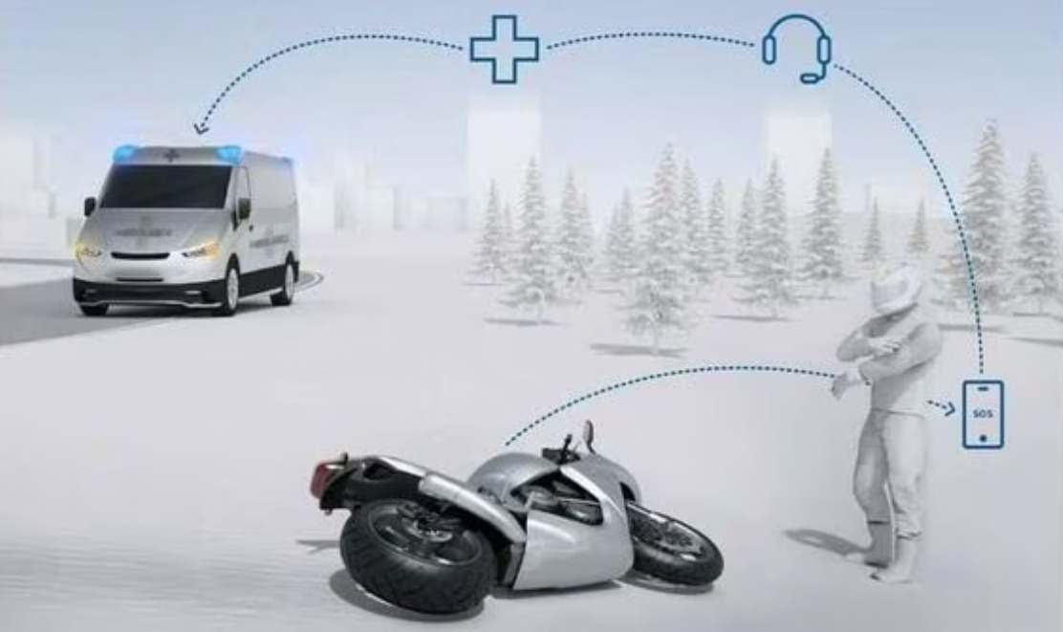
FALL DETECTION ON BIKE
An intelligent safety system that automatically detects motorcycle accidents and alerts emergency services
BY:
LUCKSHANA.G [927624BEC116]
MAHALAKSHMI.R [927624BEC120]
KARTHIKAA.S [927624BEC097]
KAVISHKA.B [927624BEC102]

Slide 2

Introduction
Bike Fall Detection is an advanced safety system engineered to detect motorcycle accidents using precision sensors and real-time data processing. The system instantly transmits emergency alerts via NB – IOT sensor networks, including the bike's exact GPS coordinates to enable rapid emergency response.
This cutting-edge technology significantly enhances rider safety and can be seamlessly integrated into motorcycles or smart helmets, providing continuous protection for riders on every journey.

Slide 3
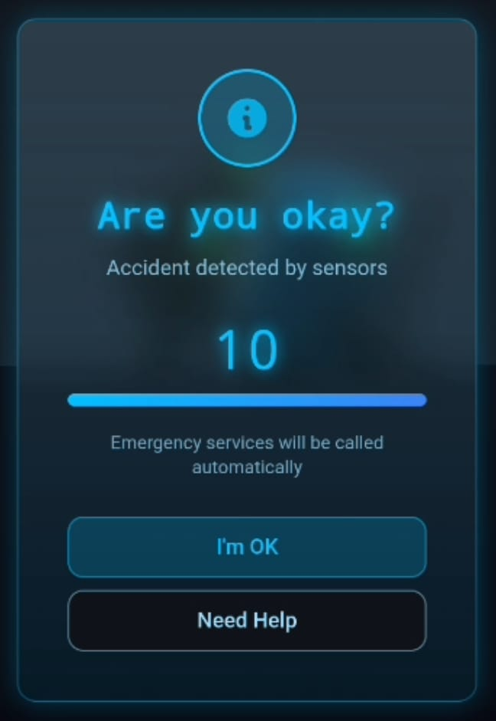
Problem Statement
Delayed Medical Response
Communication Barriers
Many motorcycle accident victims face critical delays in receiving emergency medical care, leading to preventable fatalities and severe injuries.
Manual emergency calls often
fail when riders are unconscious, disoriented, or unable to reach their mobile devices after an accident.
Automation Need
The urgent requirement for an intelligent, automatic fall detection system that operates independently of rider consciousness or intervention.

Slide 4
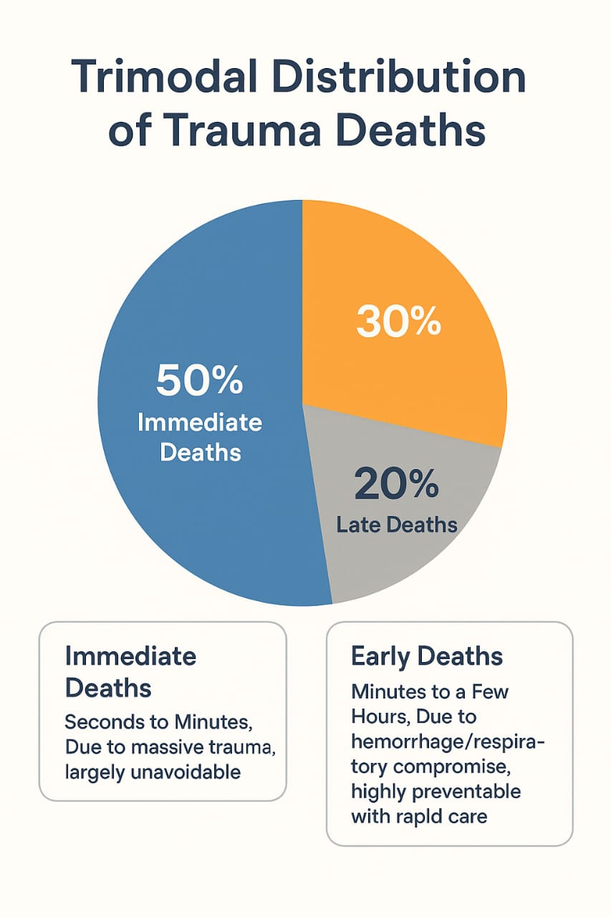
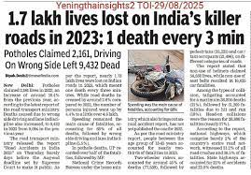
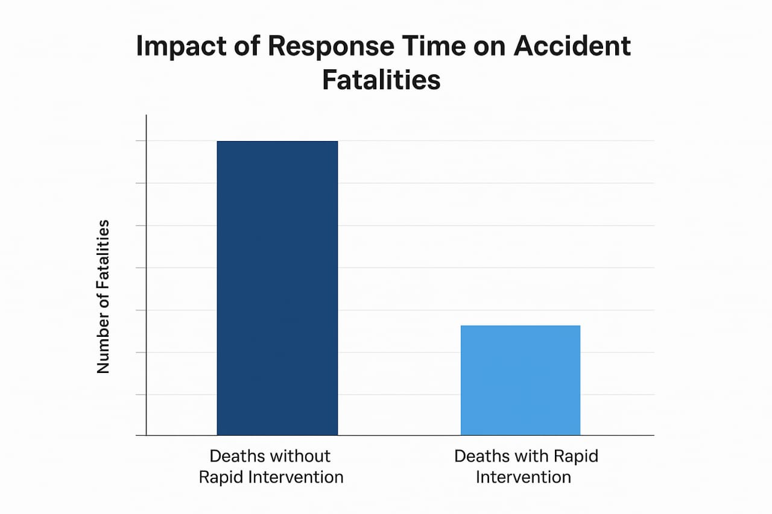
Smart Motorcycle Fall Detection System: Saving Lives Through Intelligent Emergency Response
An advanced IoT-based safety system that automatically detects motorcycle accidents using multi-sensor technology and instantly alerts emergency services with precise GPS coordinates. This life-saving innovation addresses the critical gap in emergency response time for motorcycle accidents, where every second counts.

Slide 5
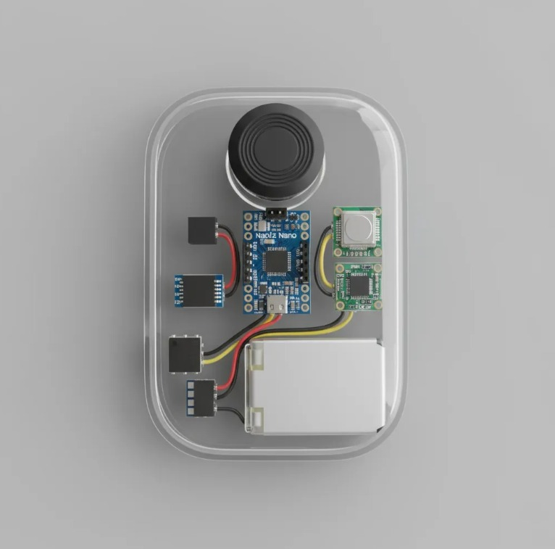
Proposed Solution
01
02
Multi-Sensor Integration
Real-Time Motion Analysis
Advanced accelerometer and gyroscope sensors continuously monitor bike orientation, velocity, and impact forces with high precision.
Sophisticated algorithms process motion data in real-time to distinguish between normal riding patterns and actual fall scenarios.
03
Instant Alert System
Upon confirmed fall detection, the system automatically sends SMS alerts with GPS coordinates to pre-configured emergency contacts and services.

Slide 6

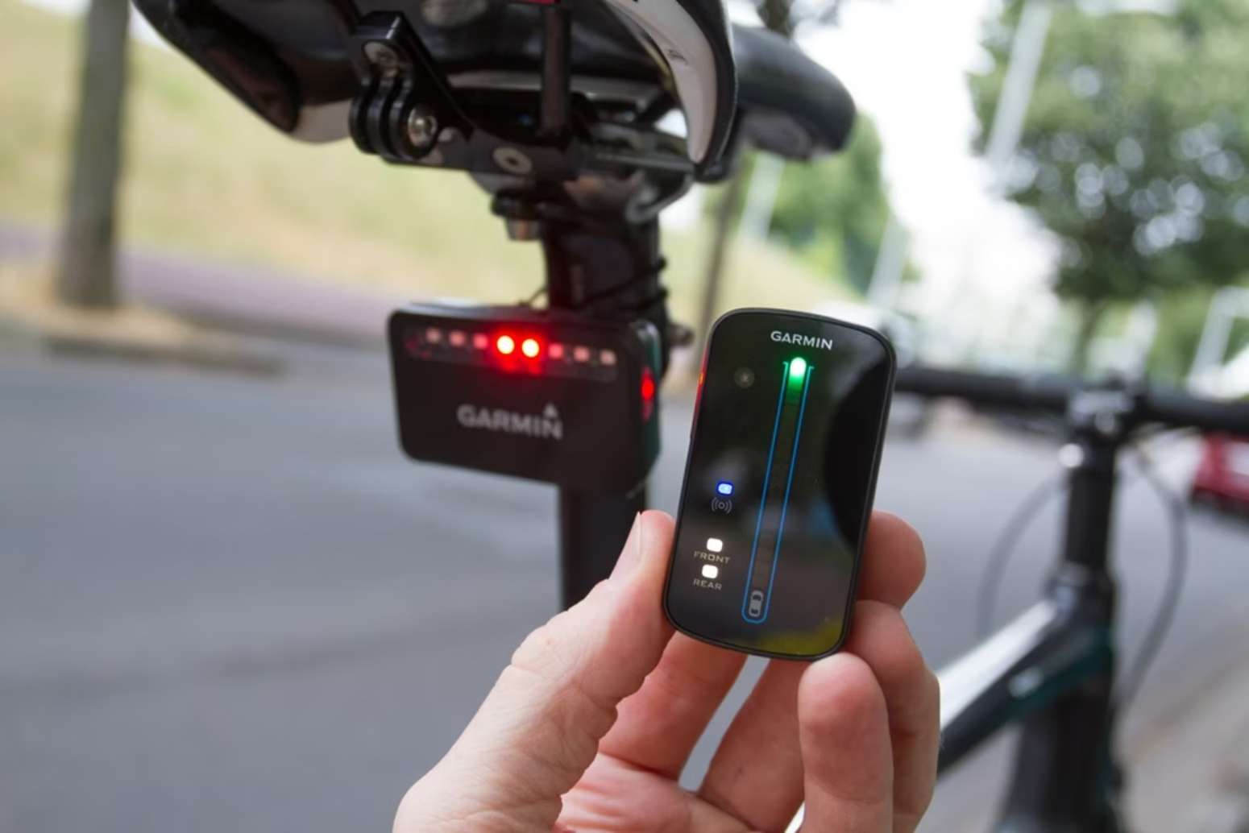
Existing vs Proposed Solution
Existing Product
Proposed Solution
Basic detection systems with limited accuracy and manual intervention requirements
Intelligent, fully-automated system with enhanced precision and immediate emergency response capabilities

Slide 7
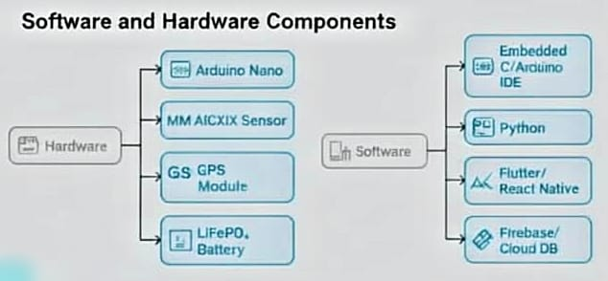
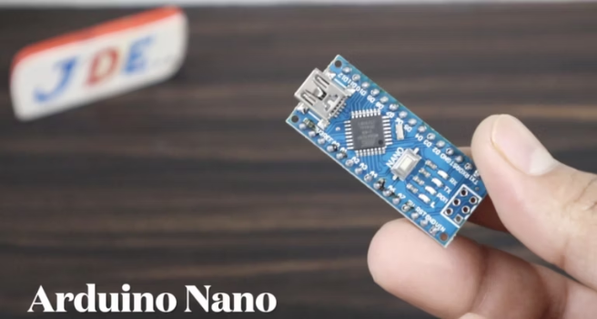
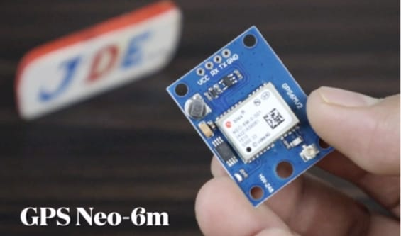
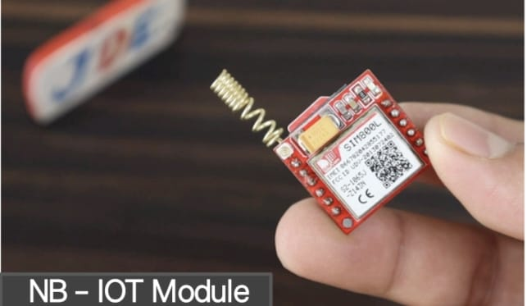
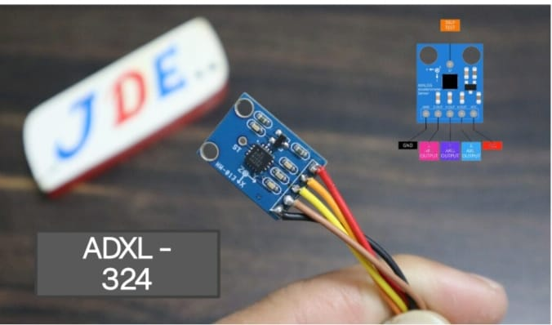
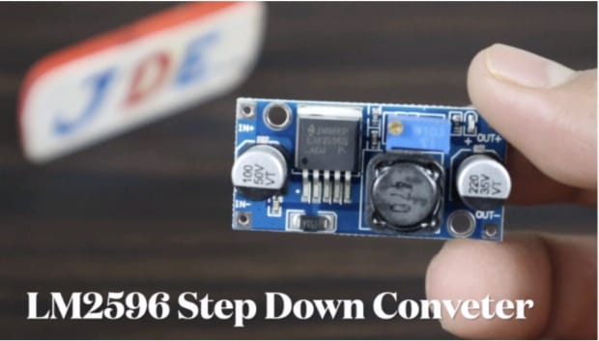
Components
Arduino Nano
The main microcontroller for reading sensors and controlling outputs
GPS Module
Provides precise location tracking for emergency response coordination
NB-IoT Module
ADXL-324 Accelerometer
High-sensitivity 3-axis motion detection for accurate fall identification
LM2596 Step Down Convertor
Used to safety reduce a higher DC voltage to a lower, stable voltage for powering electronic components
Enables reliable cellular connectivity for emergency communications

Slide 8
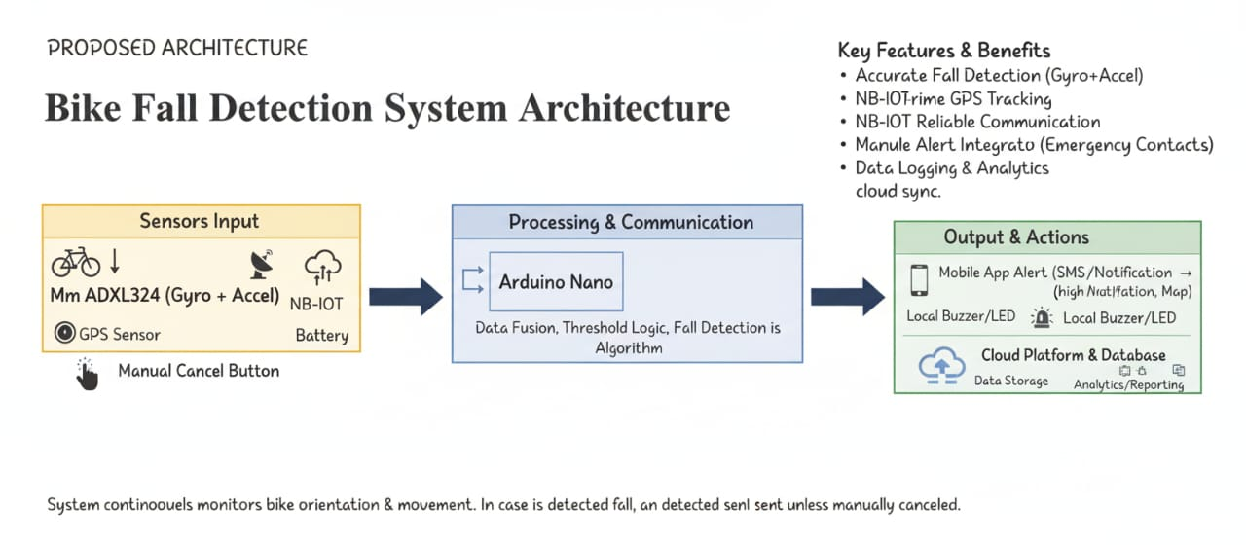

Slide 9
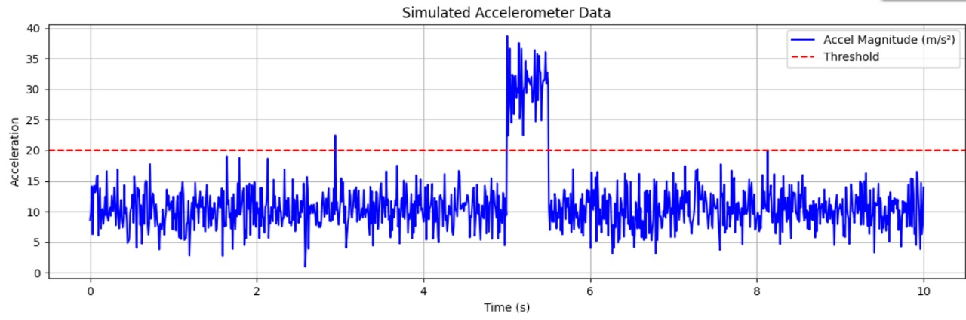


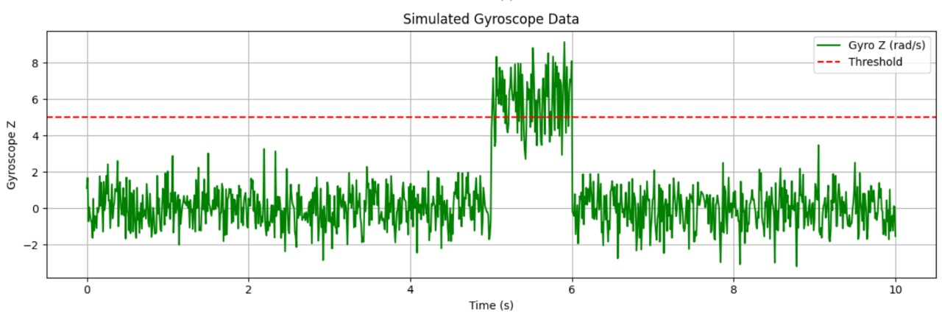


Working Mechanism
Continuous Monitoring
Multi-axis sensors continuously track bike movement patterns, acceleration, and angular velocity during operation.
Fall Detection Algorithm
Advanced algorithms analyze sensor data against predefined thresholds to identify sudden impacts, abnormal tilting, or crash scenarios.
Location Capture & Alert
Upon confirmed fall detection, the system captures GPS coordinates and immediately transmits emergency alerts with location data.
Emergency Response
Pre-configured emergency contacts and services receive instant SMS notifications enabling rapid medical response deployment.

Slide 10
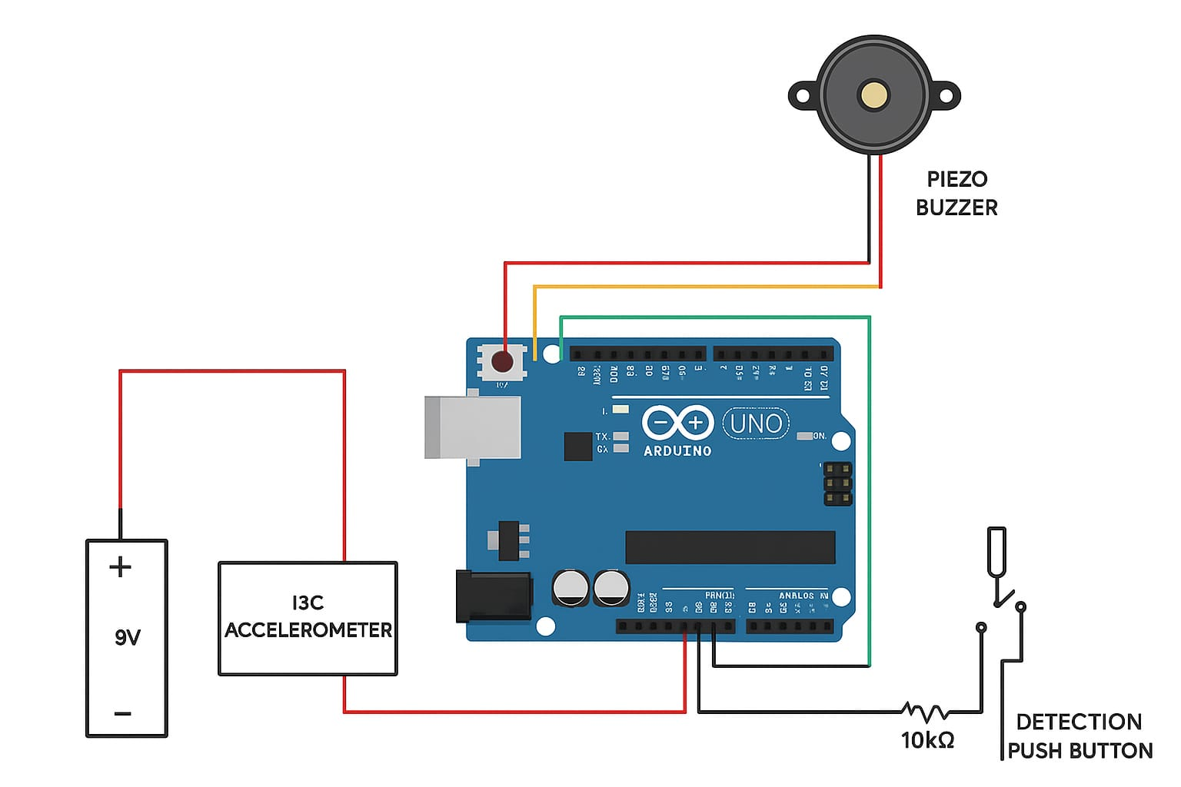
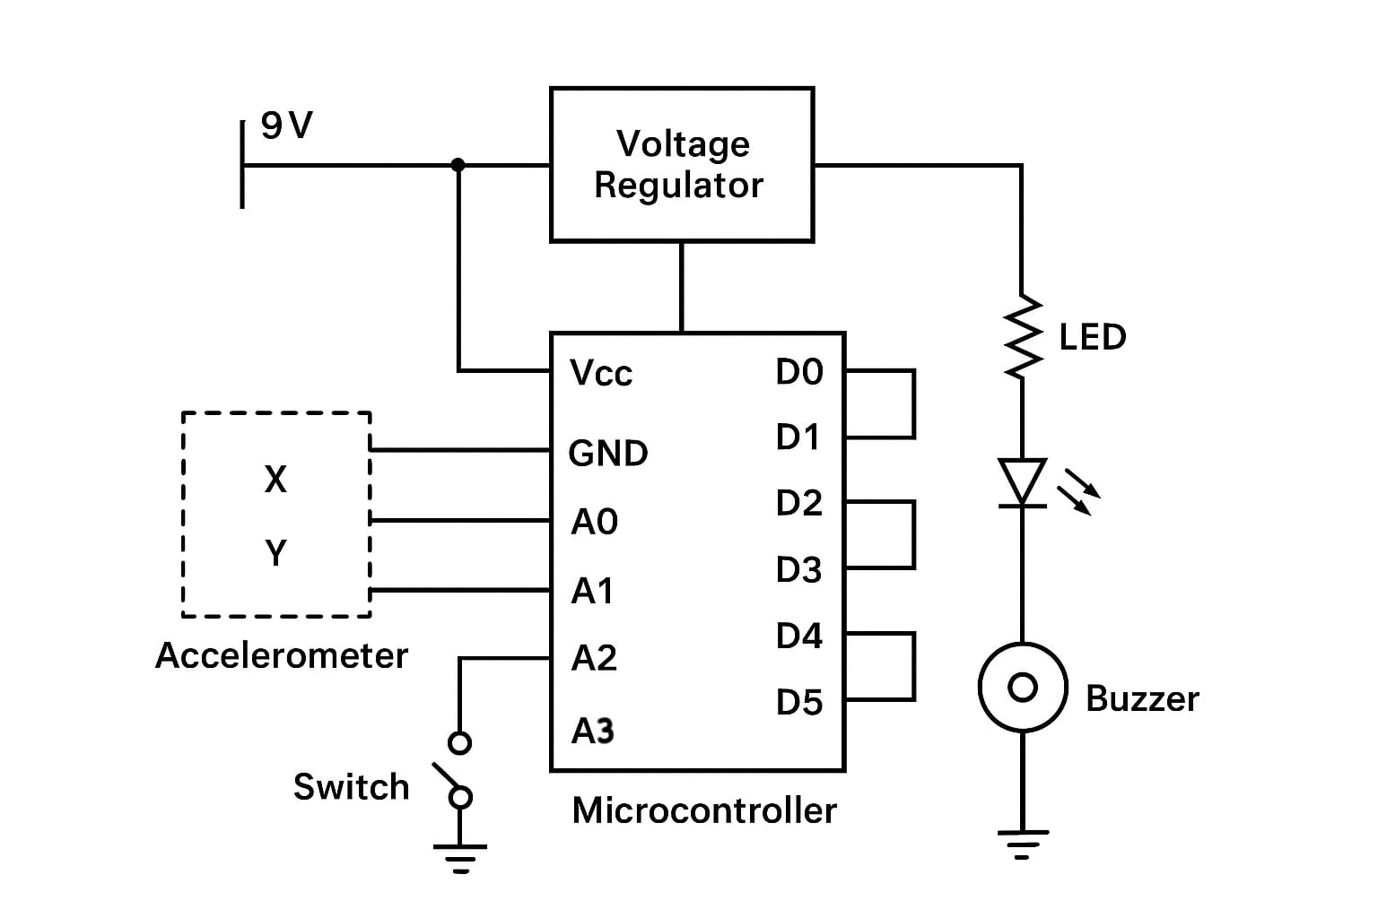
Technical Approach & Implementation
System Integration
Compact design for easy motorcycle installation
Weather-resistant housing for all-weather operation
Wireless connectivity for remote monitoring
Mobile app for system configuration and monitoring
Implementation Strategy
1
Sensor Fusion
Combine accelerometer and gyroscope data for accurate fall detection
2
Threshold Calibration
Set optimal sensitivity levels to minimize false alarms
3
Emergency Protocol
Automated SMS alerts with GPS coordinates to emergency contacts
4
Power Management
Low-power sleep modes to extend battery life
5
Real-time Processing
Edge computing for instant decision making

Slide 11
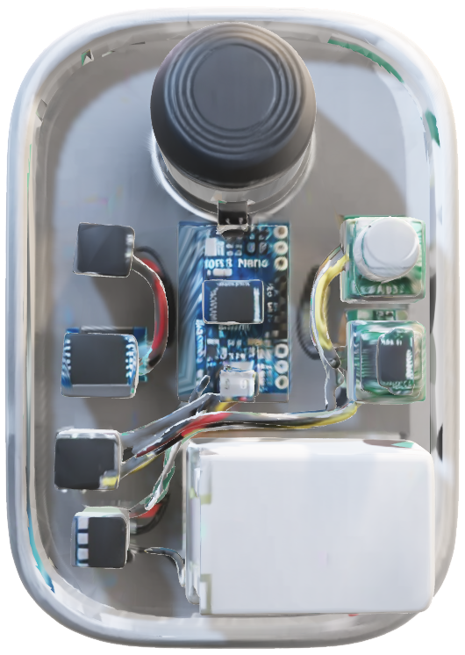
3D MODEL FOR FALL DETECTION SENSOR

Slide 12
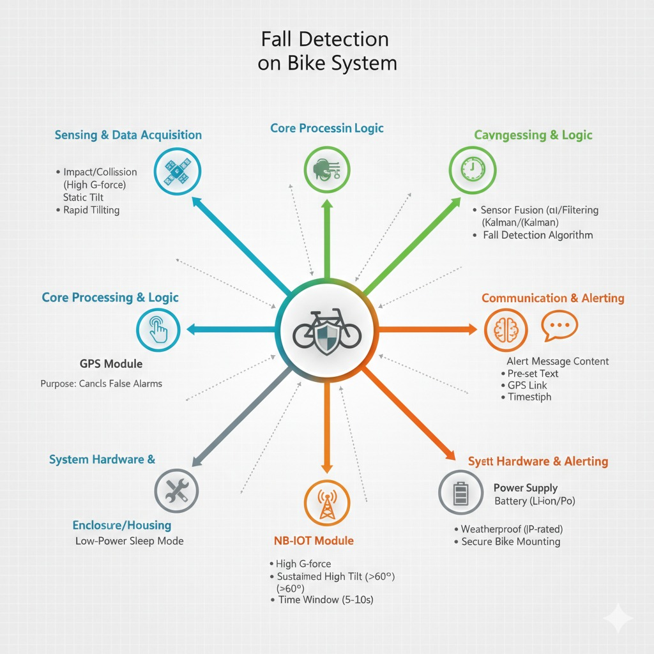

Slide 13

Challenges & Future Development
Current Challenges
Future Enhancements
False Positive Reduction
Minimizing false fall detection triggered by aggressive riding, sudden braking, or rough terrain navigation.
Enhanced Precision
Implementing machine learning algorithms to improve detection accuracy and reduce false alarms through pattern recognition.
Power Optimization
Managing sensor battery consumption to ensure extended operational periods without frequent recharging requirements.
Emergency Integration
Direct integration with emergency dispatch systems and medical response networks for automated incident reporting.

Slide 14
References
Reference link 1 : https://pmc.ncbi.nlm.nih.gov/articles/PMC4346101/?utm_source
Reference link 2 : https://jneuroengrehab.biomedcentral.com/articles/10.1186/s12984-021-00918-z?utm_source
Link for simulation output :
https://lovable.dev/projects/50e5c56d-0df4-4923-93e8-3685607a13d1

Slide 15
THANKYOU!!!

